Slide 1
Introduction to Data Science
John P Dickerson
Lecture #17 – 10/27/2020
Lecture #19 – 11/3/2020
CMSC320
Tuesdays & Thursdays
5:00pm – 6:15pm (… or anytime on the Internet)

Slide 2
Announcements
Mini-Project #2 was due late last week!
Deliverable was an .ipynb file submitted to ELMS, but moving forward this will be .pdf / .html files, for TA grading ease
Some folks had trouble getting the .pdf export to render figures – that’s okay, if we run into an issue grading, we’ll ping you
In the future: can export to .html and then convert to .pdf
Mini-Project #3 is released today!
Due slightly before Thanksgiving break

Slide 3
Today’s Lecture
Data collection
Data processing
Exploratory analysis
&
Data viz
Analysis, hypothesis testing, & ML
Insight & Policy Decision

Slide 4
Today’s lecture
Introduction to machine learning
How did we actually come up with that linear model from last class?
Basic setup and terminology; linear regression & classification
Thanks to: Zico Kolter (CMU) & David Kauchak (Pomona)
First GIS result for “machine learning”

Slide 5
Recall: Explicit example of stuff from NLP class
Score 𝝍 of an instance x and class y is the sum of the weights for the features in that class:
𝝍_{xy} = Σ θ_{n} f_{n}(x, y)
= θ^{T} f(x, y)
Let’s compute 𝝍_{x1,y=hates_cats} …
𝝍_{x1,y=hates_cats} = θ^{T} f(x₁, y = hates_cats = 0)
= 0*1 + -1*1 + 1*0 + -0.1*1 + 0*0 + 1*0 + -1*0 + 0.5*0 + 1*1
= -1 - 0.1 + 1 = -0.1
1 | I
1 | like
0 | hate
1 | cats
0 | I
0 | like
0 | hate
0 | cats
1 | –
hates_cats
likes_cats
θ ^{T} =
0 | -1 | 1 | -0.1 | 0 | 1 | -1 | 0.5 | 1
(1)
f(x₁, y = 0)

Slide 6
Recall: Explicit example of stuff from NLP class
Saving the boring stuff:
𝝍_{x1,y=hates_cats} = -0.1; 𝝍_{x1,y=likes_cats} = +2.5
𝝍_{x2,y=hates_cats} = +1.9; 𝝍_{x2,y=likes_cats} = +0.5
We want to predict the class of each document:
Document 1: argmax{ 𝝍_{x1,y=hates_cats}, 𝝍_{x1,y=likes_cats} } ????????
Document 2: argmax{ 𝝍_{x2,y=hates_cats}, 𝝍_{x2,y=likes_cats} } ????????
Document 1: I like cats
Document 2: I hate cats

Slide 7
Machine learning
We used a linear model to classify input documents
The model parameters θ were given to us a priori
(John created them by hand.)
Typically, we cannot specify a model by hand.
Supervised machine learning provides a way to automatically infer the predictive model from labeled data.
Training Data
ML Algorithm
Predictions
(x⁽¹⁾, y⁽¹⁾)
(x⁽²⁾, y⁽²⁾)
(x⁽³⁾, y⁽³⁾)
…
Hypothesis function
y^{(i)} = h(x^{(i)})
New example x
y = h(x)

Slide 8
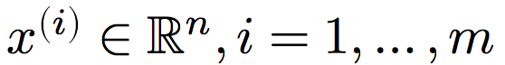
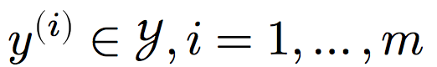
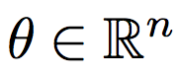
Terminology
Input features:
Outputs:
y^{(i)} ∈ {0, 1} = { hates_cats, likes_cats }
Model parameters:
I | like | hate | cats
1 | 1 | 0 | 1
1 | 0 | 1 | 1
x^{(1)T} =
x^{(2)T} =
θ ^{T} =
0 | -1 | 1 | -0.1 | 0 | 1 | -1 | 0.5 | 1

Slide 9
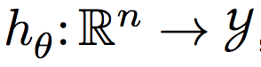
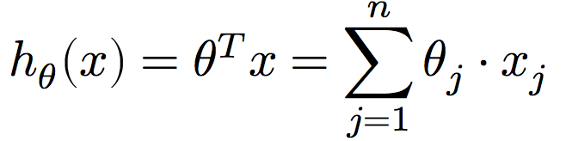
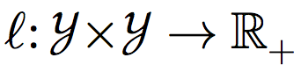
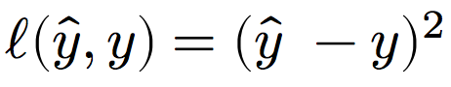
Terminology
Hypothesis function:
E.g., linear classifiers predict outputs using:
Loss function:
Measures difference between a prediction and the true output
E.g., squared loss:
E.g., hinge loss:
Output t = {-1,+1} based on -1 or +1 class label
Classifier score y

Slide 10
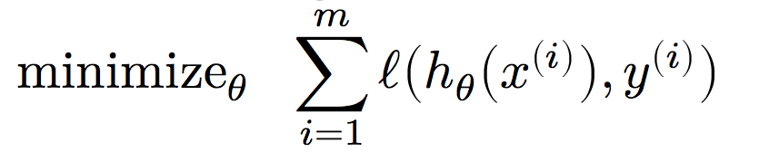
The canonical Machine learning problem
At the end of the day, we want to learn a hypothesis function that predicts the actual outputs well.
And over all your training data*
Choose the parameterization that minimizes loss!
Over all possible parameterizations
Given an hypothesis function and loss function
*Not actually what we want – want it over the world of inputs – will discuss later …

Slide 11
How do I machine learn?
What is the hypothesis function?
Domain knowledge and EDA can help here.
What is the loss function?
We’ve discussed two already: squared and absolute.
How do we solve the optimization problem?
(We’ll cover gradient descent and stochastic gradient descent in class, but if you are interested, take CMSC422!)
First GIS result for “optimization”

Slide 12
Aside: Loss functions

Slide 13
Quick aside about loss functions
Say we’re back to classifying documents into:
hates_cats, translated to label y = -1
likes_cats, translated to label y = +1
We want some parameter vector θ such that:
𝝍_{xy} > 0 if the feature vector x is of class likes_cat; (y = +1)
𝝍_{xy} < 0 if x’s label is y = -1
We want a hyperplane that separates positive examples from negative examples.
Why not use 0/1 loss; that is, the number of wrong answers?

Slide 14
Minimizing 0/1 loss in a single dimension
loss
θ
Each time we change θ such that the example is right (wrong) the loss will increase (decrease)

Slide 15
Minimizing 0/1 loss over all θ
This is NP-hard.
Small changes in any θ can have large changes in the loss (the change isn’t continuous)
There can be many local minima
At any give point, we don’t have much information to direct us towards any minima
Maybe we should consider other loss functions.

Slide 16
Desirable properties
loss
θ
What are some desirable properties of a loss function????????
Continuous so we get a local indication of the direction of minimization
Only one (i.e., global) minimum

Slide 17
Convex functions
“A function is convex if the line segment between any two points on its graph lies above it.”
Formally, given function f and two points x, y:

Slide 18
Surrogate loss functions
For many applications, we really would like to minimize the 0/1 loss
A surrogate loss function is a loss function that provides an upper bound on the actual loss function (in this case, 0/1)
We’d like to identify convex surrogate loss functions to make them easier to minimize
Key to a loss function is how it scores the difference between the actual label y and the predicted label y’

Slide 19
Surrogate loss functions
0/1 loss:
Any ideas for surrogate loss functions ?????????? Want: a function that is continuous and convex and upper bounds the 0/1 loss.
Hinge:
Exponential:
Squared:
What do each of these penalize?????????

Slide 20
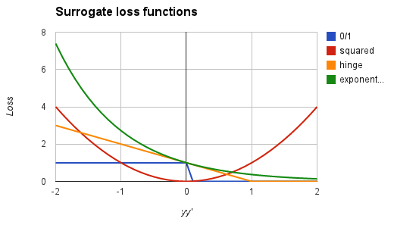
Surrogate loss functions
0/1 loss:
Hinge:
Exponential:
Squared loss:
(Recall: y in {-1, +1})
Notes:
notice, all are convex
all (except hinge) are differentiable

Slide 21
Some ML algorithms
Name | Hypothesis Function | Loss Function | Optimization Approach
Least squares | Linear | Squared | Analytical or GD
Linear regression | Linear | Squared | Analytical or GD
Support Vector Machine (SVM) | Linear, Kernel | Hinge | Analytical or GD
Perceptron | Linear | Perceptron criterion (~Hinge) | Perceptron algorithm, others
Neural Networks | Composed nonlinear | Squared, Hinge | SGD
Decision Trees | Hierarchical halfplanes | Many | Greedy
Naïve Bayes | Linear | Joint probability | #SAT
Follow the white rabbit: https://en.wikipedia.org/wiki/List_of_machine_learning_concepts

Slide 23
Recall: Linear Regression

Slide 24
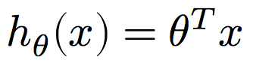
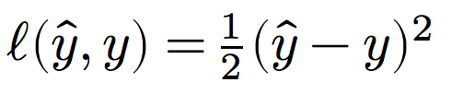
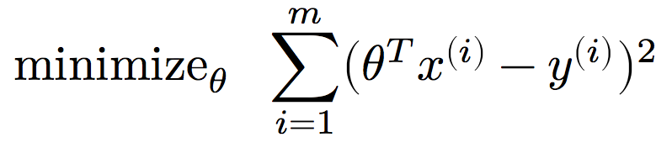
Linear regression as Machine Learning
Let’s consider linear regression that minimizes the sum of squared error, i.e., least squares …
Hypothesis function: ????????
Linear hypothesis function
Loss function: ????????
Squared error loss
Optimization problem: ????????

Slide 25
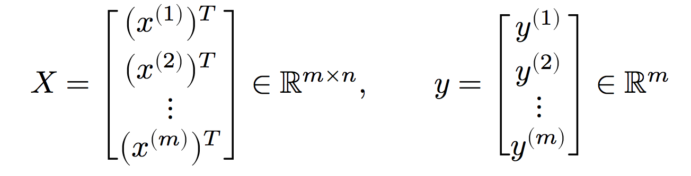
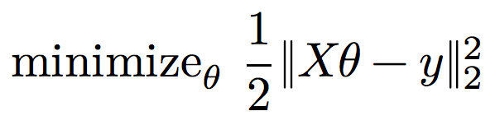
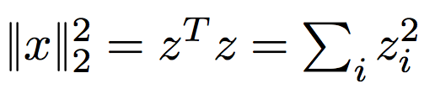
Linear regression as Machine Learning
Each row is a feature vector paired with a label for a single input
Rewrite inputs:
Rewrite optimization problem:
m labeled inputs
n features
*Recall:

Slide 26
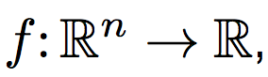
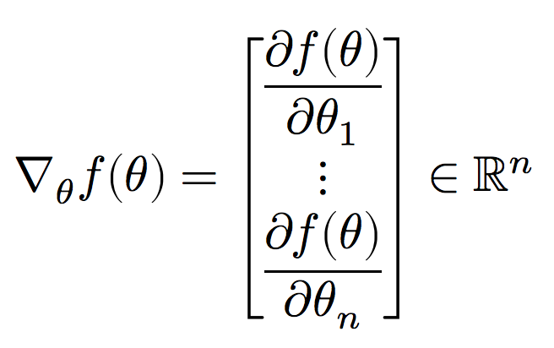
Gradients
In Lecture 11, we showed that the mean is the point that minimizes the residual sum of squares:
Solved minimization by finding point where derivative is zero
(Convex functions like RSS → single global minimum.)
The gradient is the multivariate generalization of a derivative.
For a function the gradient is a vector of all n partial derivatives:

Slide 27
Gradients
Gradient of f(x,y) = xe^{−(x2 + y2)}

Slide 28
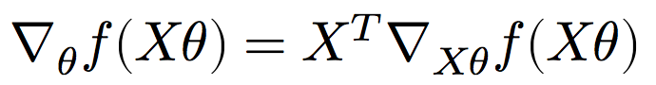
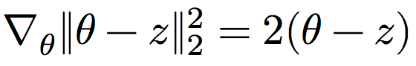
Gradients
Minimizing a multivariate function involves finding a point where the gradient is zero:
Points where the gradient is zero are local minima
If the function is convex, also a global minimum
Let’s solve the least squares problem!
We’ll use the multivariate generalizations of some concepts from MATH141/142 …
Chain rule:
Gradient of squared ℓ² norm:

Slide 29
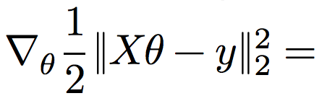
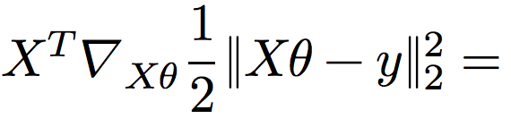
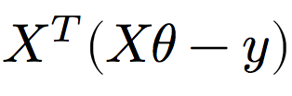
Least squares
Recall the least squares optimization problem:
What is the gradient of the optimization objective ????????
Chain rule:
Gradient of norm:

Slide 30
Least Squares
Recall: points where the gradient equals zero are minima.
So where do we go from here?????????
Solve for model parameters θ

Slide 31
ML in Python
Python has tons of hooks into a variety of machine learning libraries. (Part of why this course is taught in Python!)
Scikit-learn is the most well-known library:
Classification (SVN, K-NN, Random Forests, …)
Regression (SVR, Ridge, Lasso, …)
Clustering (k-Means, spectral, mean-shift, …)
Dimensionality reduction (PCA, matrix factorization, …)
Model selection (grid search, cross validation, …)
Preprocessing (cleaning, EDA, …)
Built on the NumPy stack; plays well with Matplotlib.

Slide 32
Least Squares in Python
You don’t need Scikit-learn for OLS …
But let’s say you did want to use it.
# Analytic solution to OLS using Numpy
params = np.linalg.solve(X.T.dot(X), X.T.dot(y))
from sklearn import linear_model
X = [[0,0], [1,1], [2,2]]
Y = [0, 1, 2]
# Solve OLS using Scikit-Learn
reg = linear_model.LinearRegression()
reg.fit(X, Y)
reg.coef_
array([ 0.5, 0.5])

Slide 33
Next, or Next Class: (Stochastic) Gradient Descent

Slide 34
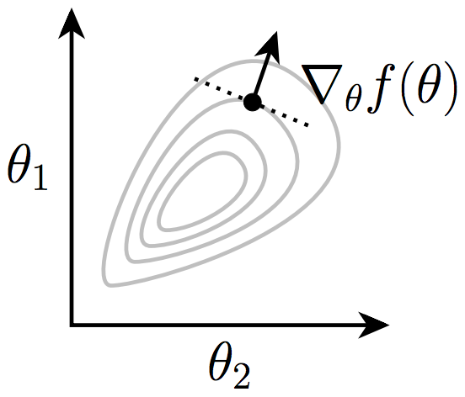
Today: Gradient Descent
We used the gradient as a condition for optimality
It also gives the local direction of steepest increase for a function:
Intuitive idea: take small steps against the gradient.
If there is no increase, gradient is zero = local minimum!
Image from Zico Kolter

Slide 35
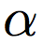
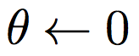
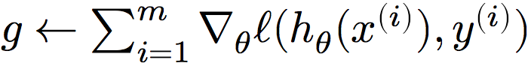
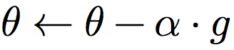
Gradient descent
Algorithm for any* hypothesis function , loss function , step size :
Initialize the parameter vector:
Repeat until satisfied (e.g., exact or approximate convergence):
Compute gradient:
Update parameters:
*must be reasonably well behaved

Slide 36
Gradient Descent
Step-size (\alpha) is an important parameter
Too large → might oscillate around the minima
Too small → can take a long time to converge
If there are no local minima, then the algorithm eventually converges to the optimal solution
Very widely used in Machine Learning

Slide 37
Example
Function: f(x,y) = x² + 2y²
Gradient: ??????????
Let’s take a gradient step from (-2, +1/2):
Step in the direction (-4, -2), scaled by step size
Repeat until no movement

Slide 38
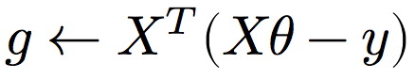
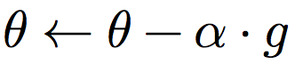
Gradient Descent for OLS
Algorithm for linear hypothesis function and squared error loss function (combined to , like before):
Initialize the parameter vector:
Repeat until satisfied:
Compute gradient:
Update parameters:

Slide 39
Gradient descent in Pure(-ish) python
# Training data (X, y), T time steps, alpha step
def grad_descent(X, y, T, alpha):
m, n = X.shape # m = #examples, n = #features
theta = np.zeros(n) # initialize parameters
f = np.zeros(T) # track loss over time
for i in range(T):
# loss for current parameter vector theta
f[i] = 0.5*np.linalg.norm(X.dot(theta) – y)**2
# compute steepest ascent at f(theta)
g = X.T.dot(X.dot(theta) – y)
# step down the gradient
theta = theta – alpha*g
return theta, f
Implicitly using squared loss and linear hypothesis function above; drop in your favorite gradient for kicks!

Slide 40
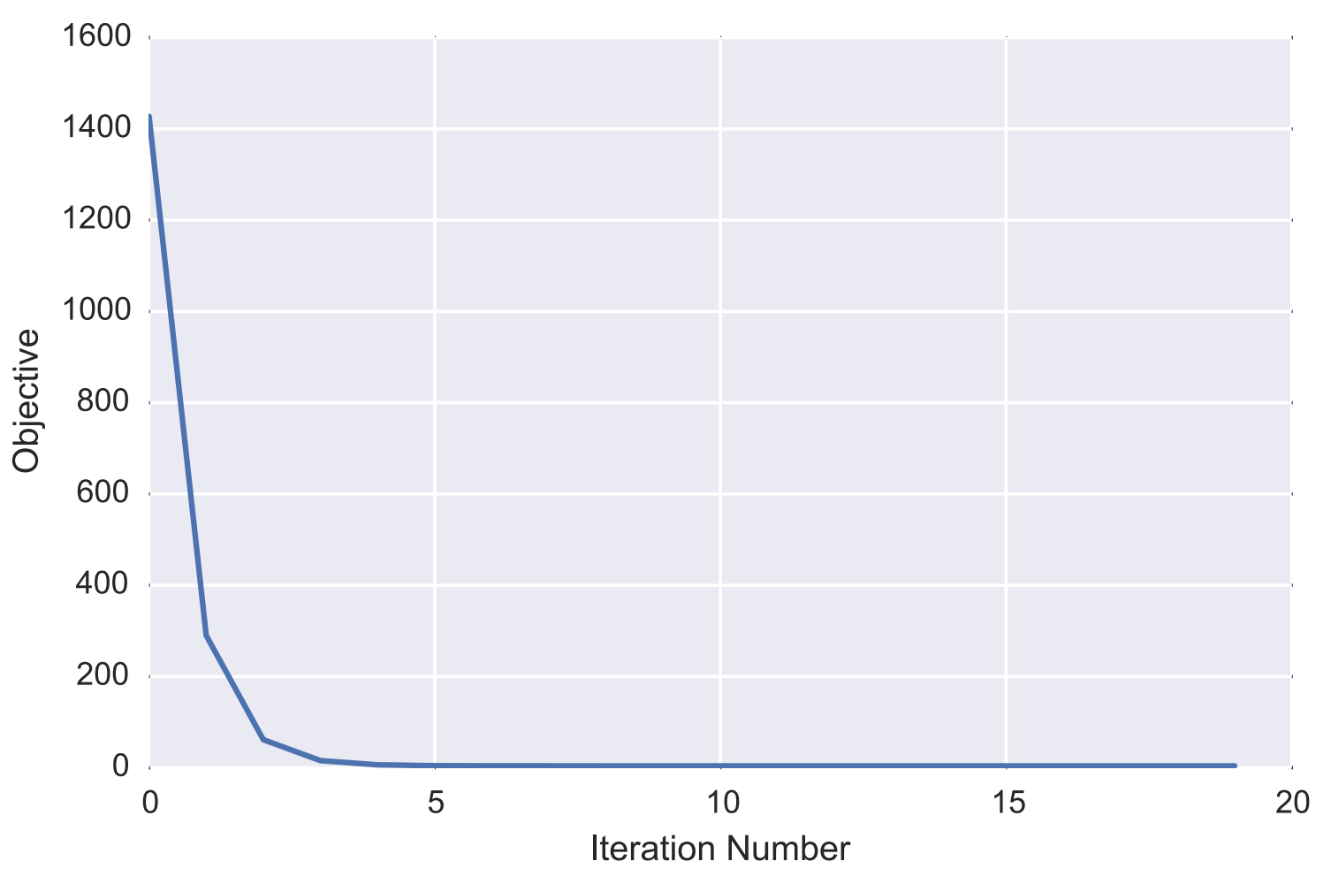
Plotting Loss over time
Why ????????
Image from Zico Kolter

Slide 41
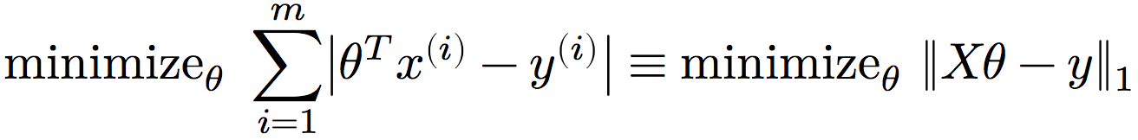
Iterative vs analytic solutions
But we already had an analytic solution! What gives?
Recall: last class we discuss 0/1 loss, and using convex surrogate loss functions for tractability
One such function, the absolute error loss function, leads to:
Problems ????????
Not differentiable! But subgradients?
No closed form!
So you must use iterative method

Slide 42
Least Absolute Deviations
Can solve this using gradient descent and the gradient:
Simple to change in our Python code:
for i in range(T):
# loss for current parameter vector theta
f[i] = np.linalg.norm(X.dot(theta) – y, 1)
# compute steepest ascent at f(theta)
g = X.T.dot( np.sign(X.dot(theta) – y) )
# step down the gradient
theta = theta – alpha*g
return theta, f

Slide 43
Batch vs Stochastic Gradient Descent
Batch: Compute a single gradient (vector) for the entire dataset (as we did so far)
Incremental/Stochastic:
Do one training sample at a time, i.e., update parameters for every sample separately
Much faster in general, with more pathological cases
From: Andrew Ng, CS229 Lecture Notes

